Slide 1
TIDAL ENERGY
NAME:G.SOWMYA
ROLL NO:22H51A0588

Slide 2

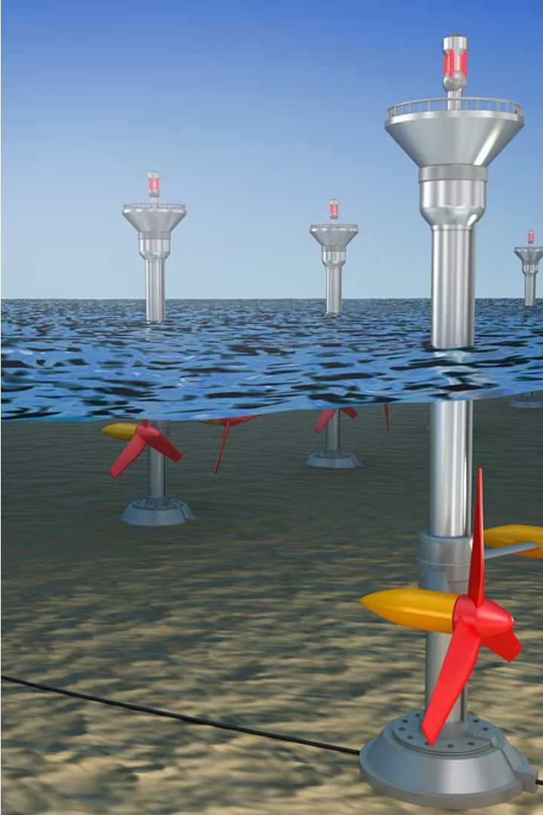
Introduction
Tidal energy is a promising renewable energy source that harnesses the power of the ocean's tides to generate electricity. As the Earth's gravitational pull and the moon's rotation create regular tidal patterns, this natural phenomenon can be captured and converted into a reliable and sustainable energy solution.

Slide 3
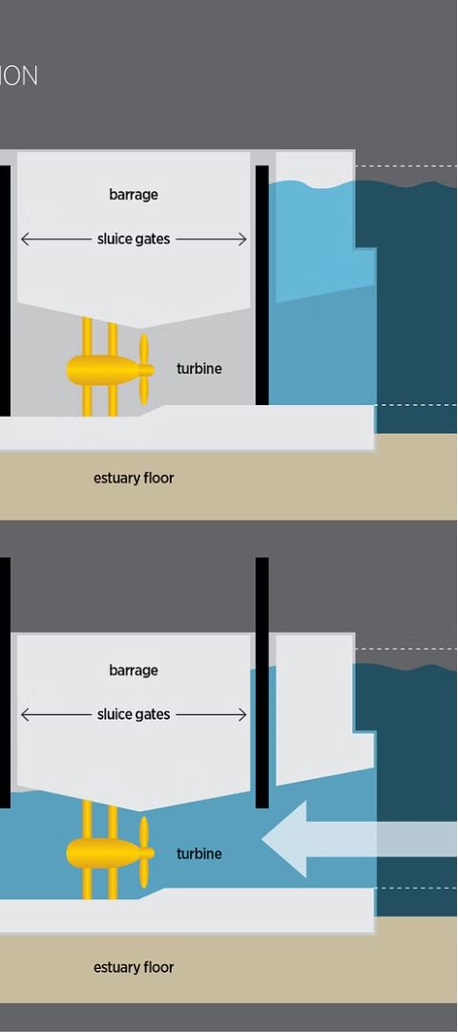
How Tidal Energy Works
1
Tidal Barrage
A tidal barrage is a dam-like structure that captures the tidal flow and channels it through turbines to generate electricity.
2
Tidal Stream
Tidal stream systems use underwater turbines to harness the kinetic energy of the moving tidal currents and convert it into electricity.
3
Tidal Lagoon
Tidal lagoons are artificial basins that fill and empty with the tide, driving turbines to produce power.

Slide 4
Advantages of Tidal Power
1
Predictable and Reliable
2
Environmentally Friendly
Tidal patterns are highly predictable, making tidal energy a reliable and consistent source of renewable power.
Tidal energy does not produce greenhouse gases or other pollutants, making it a clean and sustainable option.
3
Long-Lasting Infrastructure
4
Abundant Resource
Tidal energy projects have a long lifespan, with some installations operating for 50-100 years.
Tidal energy is an abundant resource, with vast untapped potential around the world.

Slide 5
Disadvantages of Tidal Power
High Upfront Costs
Limited Locations
Tidal energy projects often require significant initial investments for construction and installation.
Tidal energy is only viable in areas with high-volume tidal flows, limiting the potential locations for development.
Environmental Concerns
Technological Challenges
Tidal energy projects may have potential impacts on marine ecosystems and wildlife, requiring careful environmental assessments.
Developing and maintaining tidal energy technologies can be complex and technologically demanding.

Slide 6
Tidal Energy Technologies
Tidal Barrages
Tidal Turbines
Tidal Fences
Tidal barrages use large dam-like structures to capture the ebb and flow of the tides, driving turbines to generate electricity.
Tidal turbines are submerged underwater, harnessing the kinetic energy of the tidal currents to spin generators and produce power.
Tidal fences are arrays of vertical axis turbines placed across tidal channels to capture the flow of the tides.

Slide 7
Environmental Impact of Tidal Energy
1
Ecosystem Disruption
2
Sediment Disturbance
Tidal energy projects can potentially disrupt marine habitats and ecosystems, affecting local wildlife and biodiversity.
The construction and operation of tidal energy devices can disturb seafloor sediments, leading to potential water quality issues.
3
Noise Pollution
4
Visual Impacts
The operation of tidal turbines and other equipment can generate underwater noise, which may impact marine life.
Visible tidal energy infrastructure, such as barrages and offshore turbines, can potentially affect the aesthetics of coastal areas.

Slide 8
Global Tidal Energy Potential
Asia-Pacific
Europe
North America
The Asia-Pacific region, particularly in nations like South Korea, China, and India, has significant tidal energy potential.
Europe, especially the United Kingdom and France, is a global leader in tidal energy development, with several large-scale projects.
North America, particularly the eastern coast of Canada and the United States, has promising tidal energy resources.

Slide 9
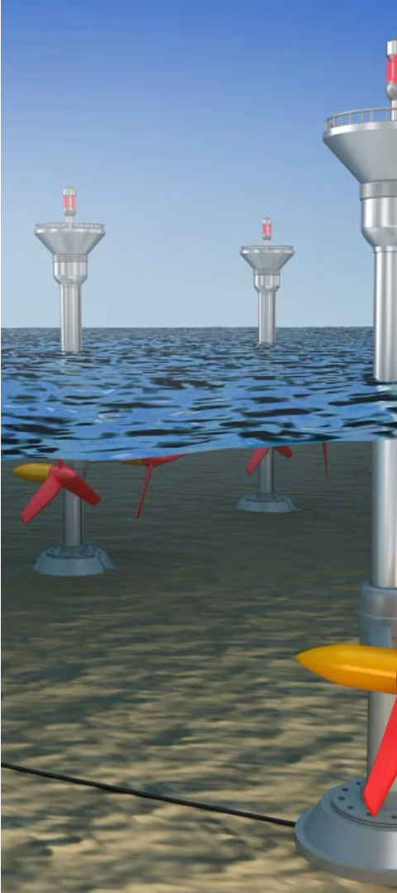

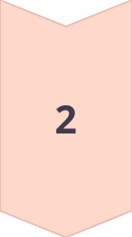

The Future of Tidal Energy
Technological Advancements
Continuous improvements in tidal energy technology, such as more efficient turbines and innovative designs, are expected to drive the industry forward.
Increased Investments
As the economic and environmental benefits of tidal energy become more widely recognized, increased investments and funding are expected to facilitate its growth.
Policy Support
Supportive government policies, such as renewable energy targets and financial incentives, will play a crucial role in the widespread adoption of tidal energy.

Slide 10
THANK YOU

